Slide 1
The resilience of the human network in the RIPE community
Presentation from a small (adhoc) group in the RIPE community
about mental health in the community

Slide 2
Goal
Open the discussion about the impact of mental health for the community members during the COVID-19 pandemic.
Investigate / query how people are dealing with mental health in the COVID-19 era
See if we can assist in providing a place to communicate/ provide a platform of like minded people
Learn, and support each other and make sure that we are not losing anyone or leaving anyone behind

Slide 3
How did this all start
In 2019, #NLNOG put the topic of burnout and working in a toxic environment on the presentation agenda
https://www.youtube.com/watch?v=7areInUXbyo - Erik Bais
The topic at the time was still quite taboo, even in the Netherlands. It created a lot of discussion and a much more open environment where people could discuss it amongst each other

Slide 4
Who / Why
Beginning 2021, the small group of RIPE community members discussed the topic
Present: Mirjam Kühne, Eileen Gallagher (INEX), Alastair Strachan, Vesna Manojlovic, Ulka Athale, Karla Liddle-White, myself (A2B Internet) & other RIPE NCC staff
Later joined by Carolien Vos (RIPE NCC HR Director)
Discuss if the topic would resonate within the community and if the topic should/must be discussed as it looked to be required

Slide 5
What was already going on …
Within the community, to the people that we reached out to, there was the ‘feeling’ that it would resonate ..
Little to nothing was done within local NOGs or IXP communities, with some exceptions.
Example:
The Dutch NLNOG is doing a daily ‘open for all’ - informal coffee breaks on Jitsi:
(https://nlnog.net/nlnog-coffee-break/)

Slide 6
Things scheduled and done
We decided on how we wanted to approach this.
A questionnaire was created and sent out to the RIPE community in April 2021
Discuss the topic using a plenary slot at the RIPE 82 meeting. As it is ‘semi’ anonymous
It doesn’t require additional registration and people could use the ‘excuse’ to join, under the “it is a RIPE meeting presentation”
After the RIPE 82 meeting, we plan an open-house meet up
https://trac.ietf.org/trac/ietf/meeting/wiki/110sidemeetings/ripe-health

Slide 7
Various blogs posted on RIPE Labs and LinkedIn
Vesna Manojlovic
https://labs.ripe.net/author/becha/ripe-community-resilience-network-and-belonging/
https://labs.ripe.net/author/becha/ripe-community-resilience-embracing-neurodiversity/
Carolien Vos
https://labs.ripe.net/author/carolien_vos/hr-from-home-adapting-in-a-year-of-covid/

Slide 8
Presentations in the community
INEX:
Dr Tim Green (Clinical Psychologist) presented at INEX:
https://www.youtube.com/watch?v=ZtjCiNSINFg
Apr 28, 2020

Slide 9
So why the questionnaire?
Open the thought process about the topic:
Mental health in the community
Think about work / home balance
Get some insight in time spent when people are not working …
Open people’s eyes on the relationship between (work related) stress and the physical impact

Slide 10
Example questions in the questionnaire

Slide 11
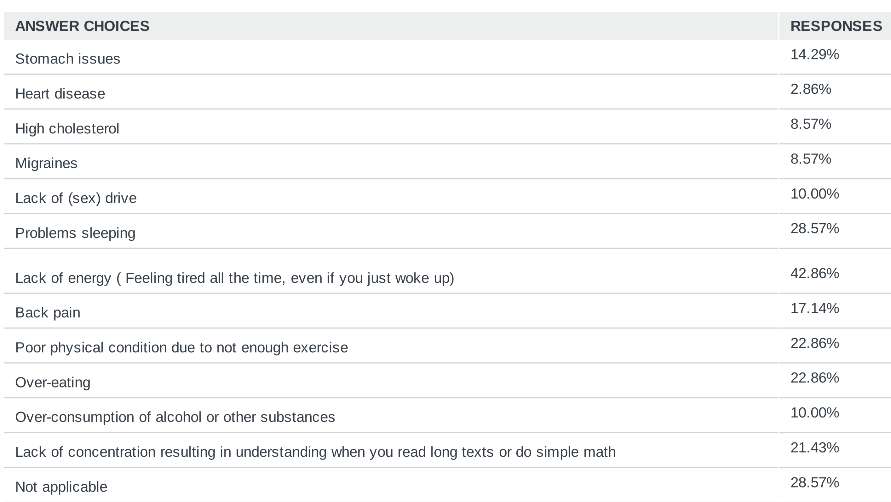
Example questions in the questionnaire

Slide 12
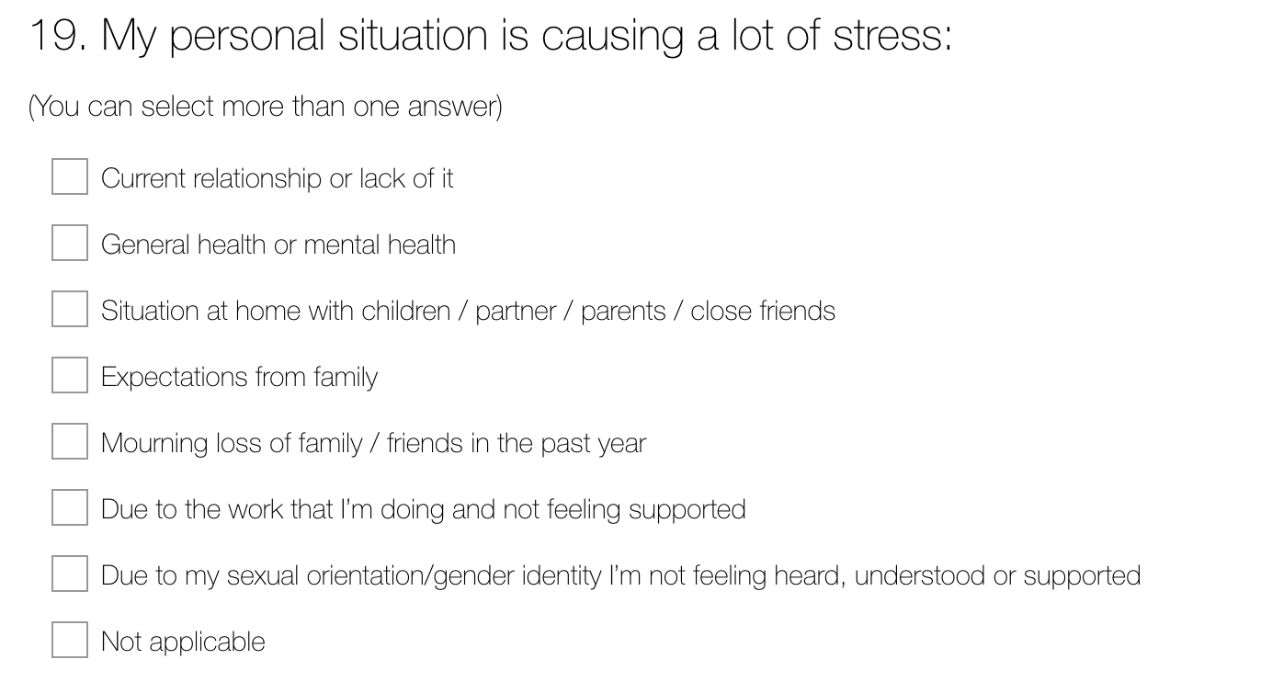
Example questions in the questionnaire

Slide 13
Example questions in the questionnaire

Slide 14
So how are we doing …?

Slide 15
So “how are we doing?”
Most of the people replied : I’m fine … ( 68 %)
Already had prior issues, but the situation isn’t helping ( 26.7 % )
Already had prior issues, but it is easier now ( 4.49 %)

Slide 16
If someone asks you “How are you …?”
How do you respond?
Is that a curtesy question with an expected reply: ‘I’m fine?’
Or are they genuinely asking about your mental state: ‘How do you feel?’
Context, culture and who is asking

Slide 17
What happens if you...
Would you actually tell me how you feel?
What happens if you say that you are struggling with …
The COVID-19 social distancing
The kids running around the house while you are trying to juggle work
The (near) future due to financial stability
Feel lonely
Or suffer from the loss of someone you knew or love

Slide 18
Do you worry about your financial situation?

Slide 19
Is talking about emotions / feelings accepted …

Slide 20
Is talking about emotions / feelings accepted …
In certain countries or religion groups
Especially if in those groups or cultures:
Depression or suicide officially doesn’t exist
Or being gay is criminalized
Or isn’t talked about

Slide 21
Some grim stats
2/3 of the people who die due to suicide are male
They are in the age group : between 40 – 70 years old
Depression is the most common mental health issue in this group
Per year 1,900 people die (in The Netherlands alone) by suicide.
Which is on avg. 5 per day (Attempts is 25 times higher – about 135 per day for NL)
The group of young people dealing with depression is rising at an alarming rate.
There is still a huge taboo to talk about suicide.
Source : 113.nl ( Suicide prevention foundation in The Netherlands )
https://www.113.nl/sites/default/files/113/2020%20middelen/Factsheet-suicide%20facts%20and%20figures.pdf

Slide 22
Q: Have you had suicidal thoughts/ideation?

Slide 23
So where do we stand currently …
Most people responded about:
Experiences of stress in relation to work or private related issues
Kids being home schooled while trying to work
Feeling cut out of their regular social environment due to COVID-19/ feeling lonely
Feeling of insecurity about financial future
Some responded about burnout related effects or experiences.
Some responded about depressions and/or suicide

Slide 24
Is there a magic solution?
Unfortunately not
However being able to talk about this … being heard … recognising that someone isn’t alone ... helps
Can we, as a community, provide a way to discuss these topics to relieve the feeling or perception of being alone in this?
Offer some assistance by listening or even acknowledging that work related stress is more common than one would initially think

Slide 25
The RIPE Community
The RIPE Community is all of us …
This isn’t only when we are talking about IPv4 or v6 .. Or Routing policies or charging schemes
We need each other and as a (healthy) community that also means that we should provide assistance for people when we are not feeling ok. Or stressed.

Slide 26
What now ?
We’re planning an Open House meetup
The Mental Health initiative group is going to review the results of the questionnaire and community response and discuss the topic of a communication platform.
Decide from there, on where and how.

Slide 27
How can you help ?
Talk to the Program Committee of your local events / NOG / IXP … See if you can get this topic discussed in your local community
Provide a listening ear for people who could need someone to talk to .. Exchange your experiences amongst each other
Sometimes you’re a mentor, other times a mentee.
Avoid judging people about mental health related issues... It is how we perceive and react, that really makes a difference in our lives

Slide 28
Need to reach out ?
Feel free to reach out to the Mental Health initiative group.
We are not professionals, we care and listen and can perhaps give some advice.
Vesna Manojlovic – BECHA @ripe.net Erik Bais – erik @bais.name
Carolien Vos – cvos @ripe.net Eileen Gallagher - eileen.Gallagher @inex.ie
In case of suicide thoughts, call your general practitioner or reach out to a national suicide hotline.
https://en.wikipedia.org/wiki/List_of_suicide_crisis_lines

